Slide 1
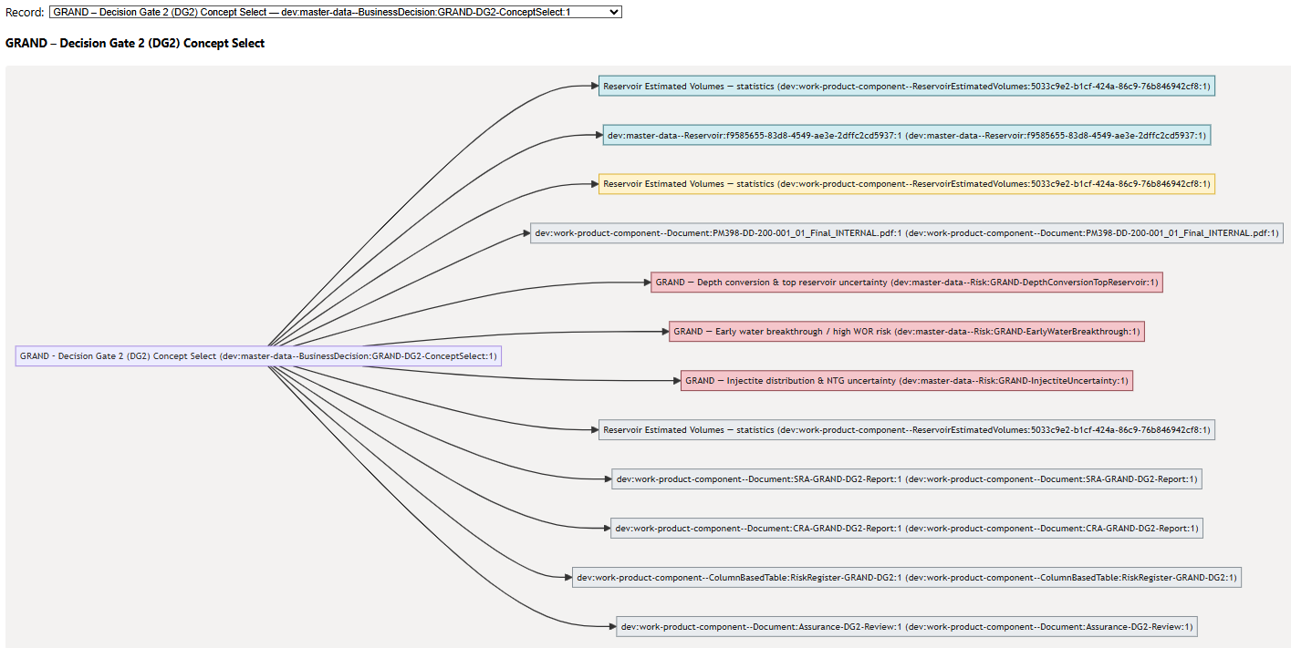
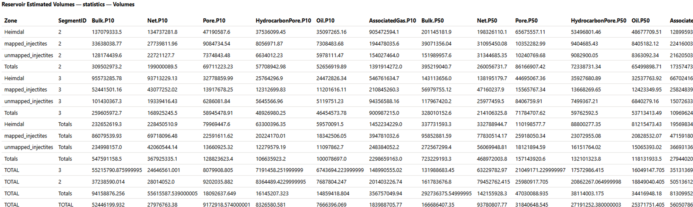
DG1-DG2-DG3-DG4: “BusinessDecision” in OSDU with Demo Grane GRAND
maap@equinor.com

Slide 2
Why OSDU for DG1–DG4 Decision Traceability
Performance Tracking
Compare volumetric estimates across DG1–DG4 and attribute changes to input parameters. What changed between DG?
Uncertainty Calibration
Use outputs to discover data relationships; refine input distributions for improved future field development decisions. Why changes between DG?
Risk Governance
Link risks and mitigations to decisions for audit readiness.
Evidence Consolidation
Package volumes, design matrices, and assurance documents under BusinessDecision. Allow for rich queries.
Notes:
Decision gates DG1 through DG4 represent critical milestones in subsurface project workflows, where concept selection, sanction, and start-up decisions are made based on complex technical and economic evidence. Historically, these decisions relied on siloed files and spreadsheets, making it difficult to track changes, justify decisions, and audit risk mitigation. OSDU provides a canonical data model that enables traceability by linking inputs, outputs, and governance artifacts through standardized objects. The business value includes improved performance tracking across gates, enabling teams to compare P10, P50, and P90 volumetric estimates and understand why they changed. It also supports an uncertainty improvement loop, where outputs from prior gates inform calibration of input distributions for future scenarios. Risk governance becomes auditable because risks, mitigations, and residual acceptance are linked directly to decision records. This transparency reduces compliance risk and accelerates assurance processes. By using BusinessDecision as the decision spine, organizations can consolidate evidence packages, including ReservoirEstimatedVolumes (REV) for authoritative volumes, ColumnBasedTable for design matrices, and Document WPCs for SRA/CRA reports. GeoLabelSet complements this by publishing headline metrics for dashboards. Together, these components create a robust ecosystem where decisions are not just recorded but contextualized with provenance, enabling analytics that improve decision quality and reduce uncertainty over time.

Slide 3
Strategy: Bridging the Gap between Decision Gates with OSDU data records
The Current State: Pre-DG1 volumes/inputs stored in GeoX.
The Issue: No standard method between DG1 and DG4+ leads to data silos, loss of links, no query.
The Goal: Implement lossless, formalized input-output provenance through OSDU.
Benefit: Facilitates performance tracking and maturation analysis.

Slide 4
OSDU Uncertainty and volumetric data: building blocks
Master‑data (anchors for scope)
master-data—Reservoir: reservoir entity of interest.
master-data--ReservoirSegment — segments under the reservoir (compartments like fault block, zone, fluid region) (WPC are linked by ParentObjectID to Field/Reservoir/ReservoirSegment)
Reference‑data (governed catalogs)
Units: reference-data--UnitOfMeasure (e.g., m3, Mm3).
Statistics facets: reference-data--FacetType:statistics, reference-data--FacetRole: {P10,P50,P90,ArithmeticMean,Minimum,Maximum,StandardDeviation}.
Canonical volume property types: reference-data--ReservoirEstimatedVolumePropertyType: {Bulk,Net,Pore,HydrocarbonPore,Oil,AssociatedGas}.
Work‑product components (WPCs)
Design Matrix, Time series etc. — work-product-component—ColumnBasedTable (generic object in OSDU).
Spatial data — grids, properties, as WPCs (e.g., GenericRepresentation: STOIIP 2d grid map).
Output volumes — work-product-component--ReservoirEstimatedVolumes, raw per‑realisation and aggregated statistics
Collections for scenarios/cases
WorkProduct — covering versioned package: yearly revisions, PUD, DG … (design/input, Activities, outputs).
CollaborationProjectCollection — curated working set while iterating.
Activity semantics (AbstractProjectActivity)
Use Parameters[] with ParameterRole = input|output|context and ObjectParameterKey to record run inputs/outputs and context.
Notes:
Managing input uncertainty in OSDU involves persisting FMU design matrices and static bundles in structured formats. The design matrix should be stored as a ColumnBasedTable with key columns such as CaseID, Realisation, and optional Seed, alongside parameter vectors representing uncertainty drivers like NTG shifts or permeability multipliers. Static bundles, including grids and property models, are captured as work-product components and grouped into WorkProduct packages for decision gates or CollaborationProjectCollections for iterative development. Provenance is maintained through activity semantics: join keys like realisation-index are stored in Keys[] arrays within Parameters[], ensuring that each input row can be linked to its corresponding output realization in ReservoirEstimatedVolumes raw datasets. This approach enables sensitivity analysis, calibration of input distributions, and transparent decision-making. By referencing these artefacts in BusinessDecision records, organizations can demonstrate how uncertainty was managed and how evidence supported gate approvals.

Slide 5
Structure and Role of BusinessDecision
DecisionLevelID | Reference to DG level (DG1–DG4)
ApprovalStatusID | Approved, ApprovedWithChanges, or Rejected
RiskIDs | List of linked Risk records
PriorActivityIDs | Anchor to primary evidence artefact (e.g., volume stats)
Parameters[] | Detailed provenance of inputs and context
Notes:
BusinessDecision is the canonical master-data object that represents a decision gate in OSDU. Each DG1–DG4 milestone should have one BusinessDecision record capturing governance metadata and provenance. Typed fields include DecisionLevelID, ApprovalStatusID, DecisionDate, and DecisionSummary, enabling simple filtering and reporting. Governance linkage is achieved through RiskIDs and RiskAssessmentDocument, while PriorActivityIDs anchor the primary evidence artefact, typically an aggregated ReservoirEstimatedVolumes dataset. Provenance is detailed in Parameters[], which enumerates all inputs, outputs, and contextual references using ParameterRoleID and ParameterKindID. This structure supports lossless traceability, allowing queries to reconstruct the evidence package and join design matrix rows to volumetric outputs. By adopting this pattern, organizations can standardize decision documentation, reduce ambiguity, and enable analytics that compare decisions across gates. BusinessDecision thus becomes the backbone of decision governance, connecting technical artefacts, risk registers, and assurance documents in a single, queryable object.

Slide 6
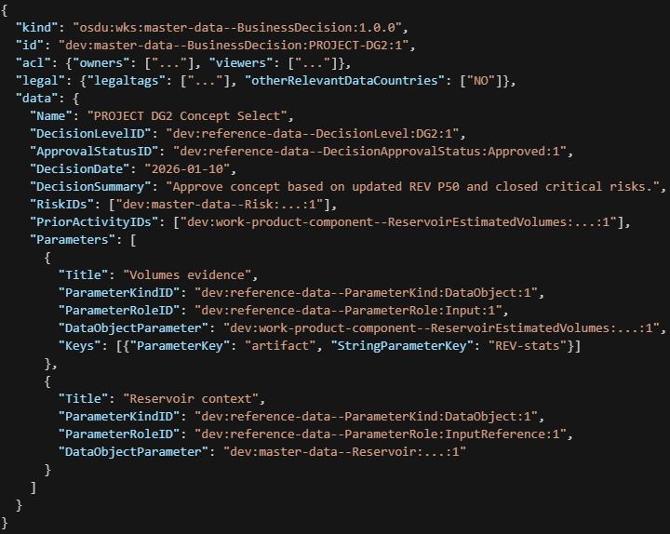
BusinessDecision minimal example

Slide 7
Notes:
BusinessDecision is the canonical master-data object that represents a decision gate in OSDU. Each DG1–DG4 milestone should have one BusinessDecision record capturing governance metadata and provenance. Typed fields include DecisionLevelID, ApprovalStatusID, DecisionDate, and DecisionSummary, enabling simple filtering and reporting. Governance linkage is achieved through RiskIDs and RiskAssessmentDocument, while PriorActivityIDs anchor the primary evidence artefact, typically an aggregated ReservoirEstimatedVolumes dataset. Provenance is detailed in Parameters[], which enumerates all inputs, outputs, and contextual references using ParameterRoleID and ParameterKindID. This structure supports lossless traceability, allowing queries to reconstruct the evidence package and join design matrix rows to volumetric outputs. By adopting this pattern, organizations can standardize decision documentation, reduce ambiguity, and enable analytics that compare decisions across gates. BusinessDecision thus becomes the backbone of decision governance, connecting technical artefacts, risk registers, and assurance documents in a single, queryable object.

Slide 8
OSDU Work Product Components
ReservoirEstimatedVolumes | Volumetric outputs (raw and aggregated)
ColumnBasedTable | Input parameters/design matrix, output QA tables
Risk | Canonical risk records; typed, with local Equinor extensions
Document | Model reports, QA reports, risk mitigation plans, …
GeoLabelSet | Dashboard-friendly headline values, fast discovery tied to master data objects
Notes:
The OSDU data ecosystem for decision gates relies on a layered architecture of master-data, reference-data, and work-product components (WPCs). Master-data anchors include Reservoir and ReservoirSegment, which provide stable identifiers for volumetric calculations and segment-level analytics. Reference-data catalogs define controlled vocabularies for units of measure, statistical facets (P10, P50, P90), property types (Bulk, Net, Oil, Gas), and governance concepts like DecisionLevel and ApprovalStatus. Activity semantics are supported by ParameterRole and ParameterKind catalogs, ensuring consistent interpretation of provenance roles. Work-product components capture domain-specific artefacts: ColumnBasedTable stores design matrices and risk registers; ReservoirEstimatedVolumes persists raw and aggregated volumetric outputs; Document WPCs hold SRA/CRA reports and assurance evidence; GeoLabelSet publishes headline metrics for dashboards. Collections such as WorkProduct and CollaborationProjectCollection organize artefacts into coherent packages for gate decisions or iterative scenario development. This modular approach enables flexible ingestion, robust lineage tracking, and efficient query patterns across decision gates.

Slide 9
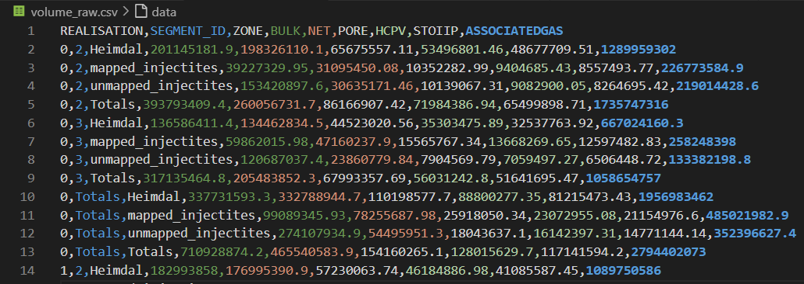
Input: Parameter and volume tables from subsurface modelling
Example: Grane Grand DG2 FMU/RMS output as csv

Slide 10
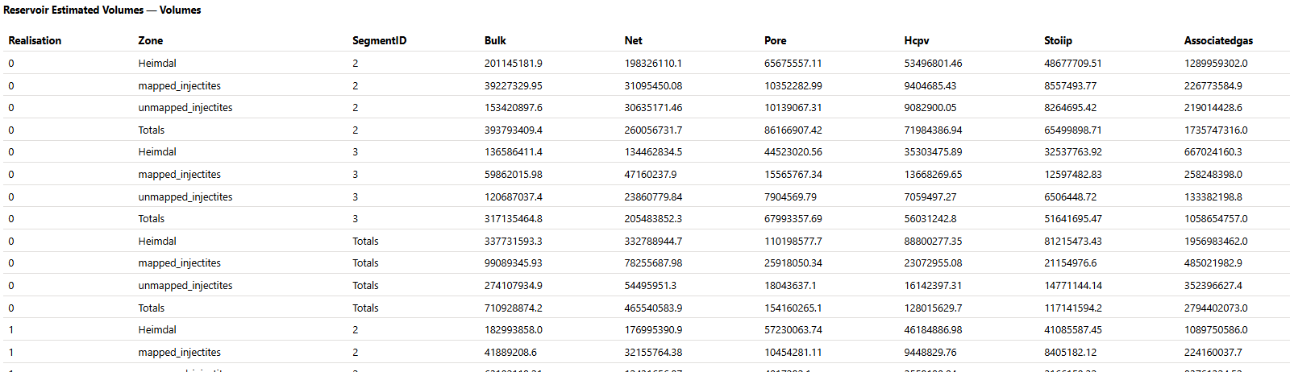
ReservoirEstimatedVolume record for ensemble output volume table
Raw volume table, assigned to MasterData objects.
KeyColumns: Realisation:int, Zone:string, SegmentID:string with KindID = osdu:wks:master-data--ReservoirSegment:2.0.0 — this ties each row to a segment
Uses OSDU canonical reference units, property types , statistical facets. Open governance: extensible – used to add to OSDU custom properties or statistical measures
Could be linked to input ensemble design matrix: as ColumnBasedTable per Realization. Use Activity to record processing

Slide 11

ReservoirEstimatedVolume table for aggregate ensemble volumes
Raw or aggregate volume table, linked to MasterData objects like ReservoirSegment
KeyColumns: Zone, SegmentID; aggregate across realizations
Canonical names; property types with statistics facets defined as reference data

Slide 12
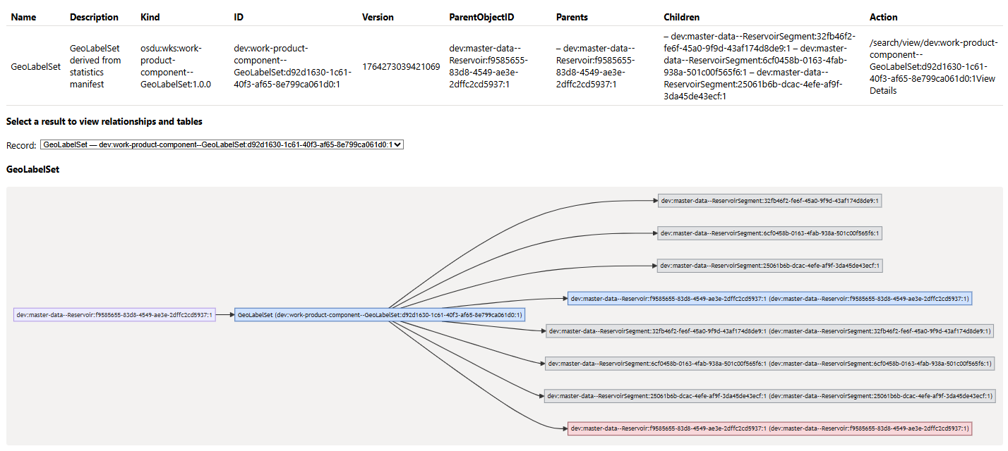
ReservoirEstimatedVolume table – Relationship to MasterData

Slide 13
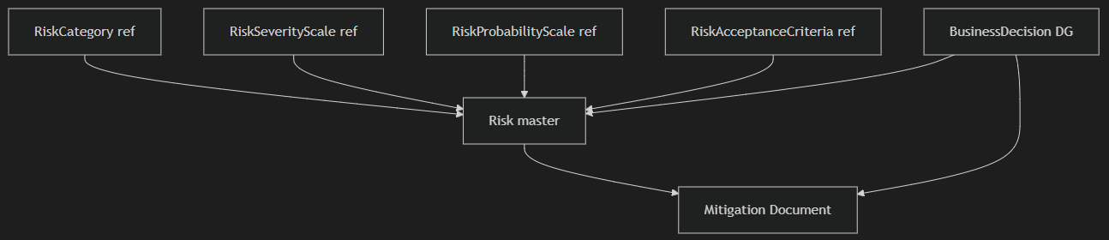
Canonical Risk Records and Equinor Extensions
Field | Purpose
RiskCategoryID | Classifies risk domain (e.g., Subsurface-Static)
SeverityScaleID | Links to severity scale reference-data
MitigationActionIDs | References Document WPCs for mitigation
Notes:
Risk management in OSDU combines canonical Risk master-data with Equinor-specific extensions. Each risk record uses kind `osdu:wks:master-data--Risk:1.2.0` and includes core fields such as Name, Summary, Description, and TypeID. Equinor-specific attributes, including category, severity, probability scales, and RAC references, are stored under data.ext.equinor. Mitigation actions are linked via Document WPC IDs, ensuring that evidence remains external and versioned. Decision gates reference risks through BusinessDecision.RiskIDs and RiskAssessmentDocument, creating a clear governance chain. Reference-data catalogs for RiskCategory, RiskSeverityScale, RiskProbabilityScale, and RiskAcceptanceCriteria ensure semantic consistency and enable powerful queries, such as filtering decisions by residual risk thresholds. This structured approach supports assurance workflows, compliance audits, and continuous improvement of risk mitigation strategies.

Slide 14
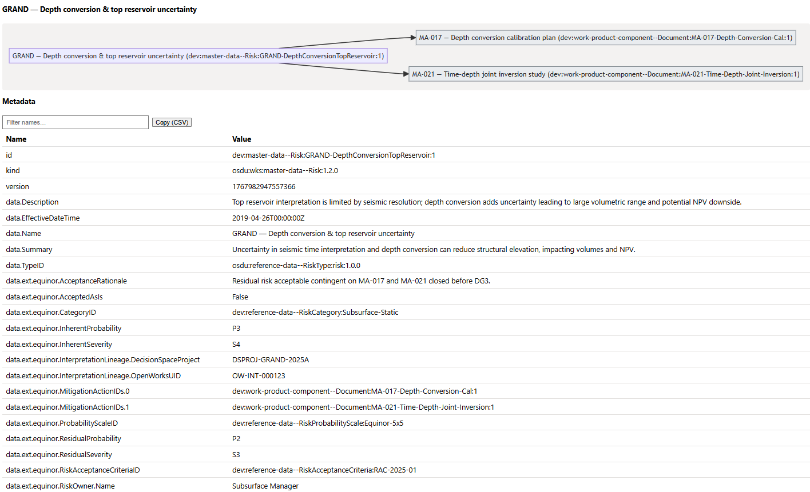
Risk Example

Slide 15
Convenience Schema: GeoLabelSet
assign arbitrary properties (e.g. volumes, average NTG) to master data objects such as ReservoirSegment

Slide 16
Query Decisions and Evidence to improve future uncertainty parametrization, risk mitigation, and decisions
BusinessDecision by DecisionLevelID | Retrieve all DG2 decisions
Join volume or property stats across gates | Compare volumetric evolution, analyse (AI?) uncertainty distributions/ granularity/maturation to detect deficiencies
GeoLabelSet by LabelledEntityID | Display property dashboard metrics related to master data elements
RiskIDs join Risk records | Assess residual risk and mitigations
Realisation | keeping provenance tight, Join on keys, Realisation input ↔ output (ensemble MC/ED matrix)
Activity | Activity carries both the design row and the volume output with the same realisation-index key in Parameters[]; records i/o and workflow processing
Case binding | WorkProduct/Collection id referenced as context to bind the scenario.
Notes:
OSDU’s structured relationships enable powerful query patterns for decision analytics. To find decisions by gate, filter BusinessDecision records using DecisionLevelID and ApprovalStatusID. Retrieve the evidence package by following PriorActivityIDs and Parameters[].DataObjectParameter to linked artefacts such as REV stats, design matrices, and documents. Compare volumetric changes across gates by aggregating Oil.P50 and Net.P50 values from referenced REV stats. For dashboards, query GeoLabelSet by LabelledEntityID and scenario facets to display headline metrics. Risk analytics can be performed by joining BusinessDecision.RiskIDs to Risk records and filtering by residual severity or probability. These patterns support assurance workflows, performance benchmarking, and uncertainty calibration, delivering actionable insights from structured decision data.

Slide 17
Resources
Demo sources
https://github.com/equinor/ores web client for RDDMS management and OSDU search (py -m uvicorn app.main:app --reload --port 8000 --env-file .\\.env)
https://github.com/equinor/ores/app/demo/py to generate manifests from csv and metadata (all master data, reference data, WPC)
https://github.com/equinor/ores/app/demo/json Grane demo manifests
https://github.com/equinor/ores/app/demo/md documentation
OSDU Schema definitions: BusinessDecision Risk Volume

